Slide 1
PG4200: Algorithms And Data Structures Lesson 01: Arrays, Lists, and Unit Tests
Bogdan Marculescu

Slide 2
Contact
“Discussion Forum” on Canvas
For announcements, and questions of general interest for the whole class
Use the discussion forum
I prefer to keep communication in Canvas and Mattermost. That way, there’s less of a chance of some messages being lost in the shuffle or otherwise forgotten.

Slide 3
Course Info
12 lessons, once a weak
Class 1-9: Foundation, algorithms and data structures that all of you will need to know if you are going to work as a developer/programmer/engineer/etc.
Class 10-12: Advanced, interesting and important topics, but that not all of you will need in your daily jobs
Check each week to see if changes in schedule (time and room)

Slide 4
Advanced
Foundation
Optimization Algorithms
Evolutionary Algorithms
Data Compression
Arrays/Lists/Tests
Stacks/Queues
Runtime analysis and Sorting
Recursion and TDD
Tree Maps
Hash Maps
Streams
Graphs
Regular Expressions

Slide 5
Class Structure
“Usually” 2+2
2-3 hours of lecture: code and slides
1-2 hours in which you should do exercises and get help
IMPORTANT: the 1-2 hours after lecture is not only for exercises. If you are falling behind, or you need some more revision, you can ask for my help on anything related to coding

Slide 6
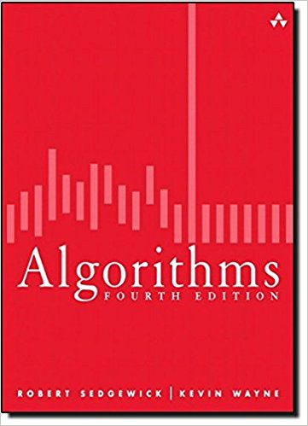
Course Material
Algorithms (4th Edition)
We actually use it in the course, so you should really try to get a copy
and likely you’ll need it also outside of this course
Note, however, that there are plenty of resources on internet to learn Algorithms

Slide 7
Git Repository
https://github.com/bogdanmarculescu/algorithms
Forked from: https://github.com/arcuri82/algorithms
Note: pull often, as new material and corrections can be added during the course
If you add code (eg working on exercises), recall to do a Git “rebase” or “stash” before pulling (which otherwise might fail)

Slide 8
Git
Git is a tool to share code among different developers in the same project
Also useful for single developers to keep track of changes, and automatically have backups on remote servers
You should have already seen the details of Git in other courses…
… but I am using Git to handle all the teaching material in this course
Note: usage of Git will NOT be part of the exam…

Slide 9

GitHub
Currently the main server repository for hosting open-source projects
Before, the main one was SourceForge
GitHub provides a website in which projects can be browsed
Projects on GitHub are handled with Git
GitHub is most famous/used, but there are others as well
eg, BitBucket and GitLab

Slide 10
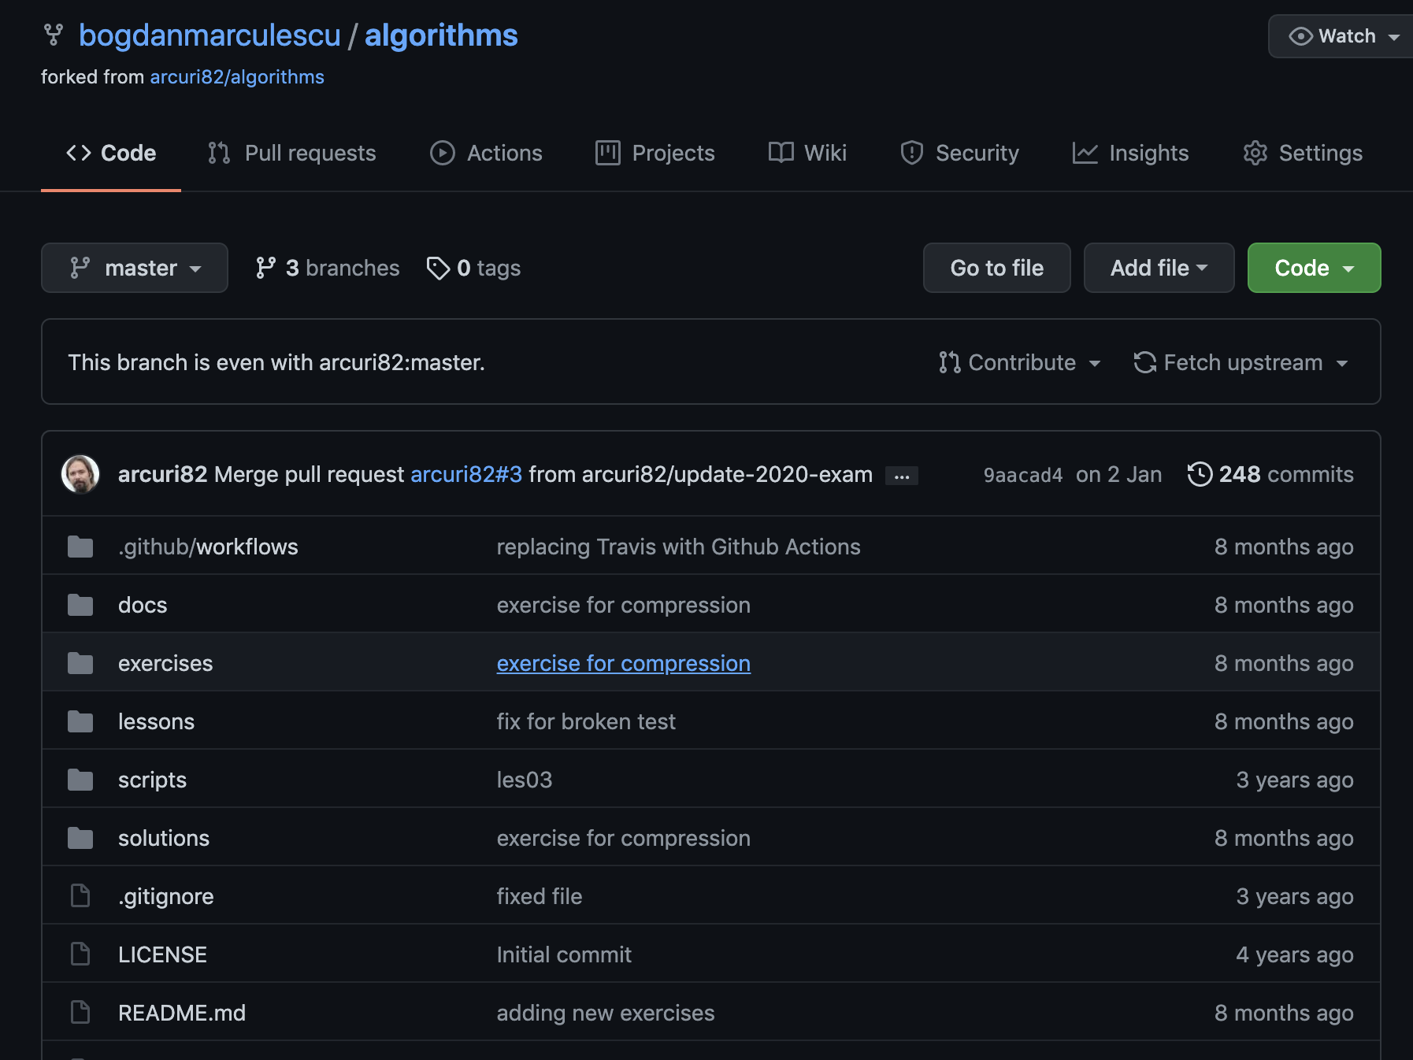

Slide 11
Git: What You Need To Do
Install Git, if you don’t have it yet
git clone https://github.com/bogdanmarculescu/algorithms.git
(or https://github.com/arcuri82/algorithms.git)
clone the repository on your local machine
git pull
update your local copy with the latest changes in the repository
Those commands can be run from a terminal, or from your IDE (eg, IntelliJ)

Slide 12
Why Study Algorithms?
Algorithms and data structures are the foundation of programming
ie, the base building blocks
Impact on all fields of engineering and science
internet, computer graphics, social networks, biology, physics, etc.
In this course, we will not build whole applications (eg, web or mobile), but rather concentrate on the building blocks to enable it in the next courses

Slide 13
Like it or not…
… used in practically most programs you will write
… algorithms and data structures are very common exercises in job interviews
Especially for juniors straight out of university
Don’t be surprised to be asked to write a stack or a queue class on a whiteboard…
… or other advanced algorithms

Slide 14
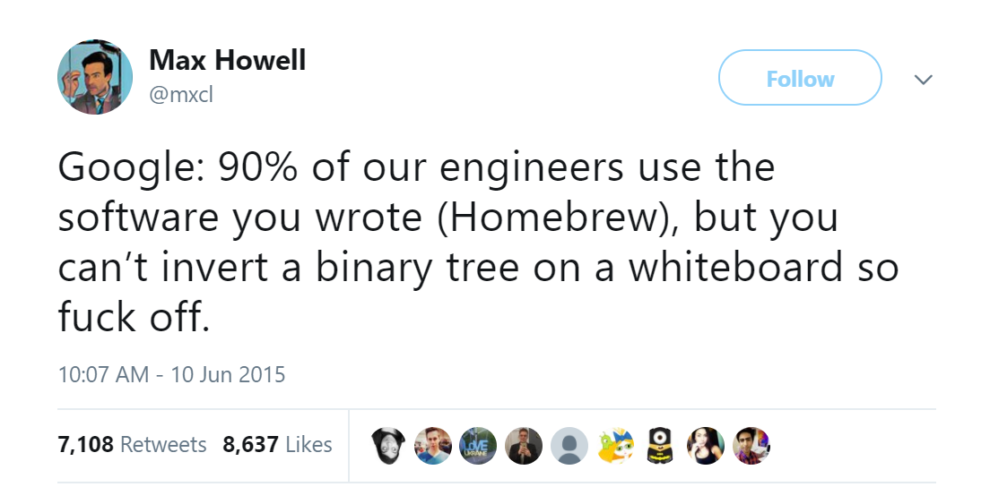

Slide 15
Math
(un)fortunately there is math involved…
Math: can tell you WHY a particular algorithm or data structure performs in a certain way
As an engineer, you need to make conscious decisions about what you use
I like math, but, in contrast to lecturers of previous years or in other universities, I put more emphasis on the programming side…

Slide 16
Coding
This course is heavily based on coding
There are going to be slides, but in class we will spend most of the time going through source code
Slides will often just be a quick overview of what we will cover in the code

Slide 17
Necessary Tools
Java 11 JDK
use OpenJDK, eg downloaded from https://adoptopenjdk.net/
Git
IntelliJ Ultimate Edition
you might want to install JetBrains Toolbox first
anyway, any other IDE would do, eg Eclipse and NetBeans

Slide 18
Java
In this course, Java is used as programming language for the examples and exercises
The concepts of Algorithms do apply to any programming language, and this is NOT a course on Java

Slide 19
Why Java?
Need object-oriented language that is strongly typed
Java: one of the most popular languages, and you have already seen it in previous courses
Kotlin: great language (my favorite), but too advanced
C#: would had been a great choice as well
C++: good choice, but can get tricky when dealing with memory allocation issues and OS dependent
JavaScript: HELL NO!!! There is a limit to sadism…
Python: not statically typed
Go: no Generic types

Slide 20
If You Skip Class…
The course is designed based on your attendance, although no strict checks
Being in class has some benefits: explanations, discussions, questions.
If you skip too many classes, it is YOUR responsibility to catch up and find out what done in class
you are adults, after all…

Slide 21
Exams
3 hour written exam
Expect 10 questions/exercises
Based on slides and all code in the repository
Only 1 question from the Advanced Topics
However this does not apply to “continuation” exams, where there can be any number
See mock exams in the Git repository
Expect theoretical questions and also the writing of code from scratch (at least 1, but usually no more than 50%)
The exam is based on what covered in the Git repository
the book just gives you extra info and clarifications
exam is based on code in the Git repository, NOT the one of the book

Slide 22
Code In The Exam
There are 12 classes which you need to know by heart, and be able to write from scratch
MyLinkedList, MyStackLinkedList, MyQueueArray, BubbleSort, InsertionSort, MergeSort, QuickSort, MyMapBinarySearchTree, MyHashMapWithLists, MyStreamSupport, UndirectedGraph, TextSearchKMP
In the exercises, you will be asked to write them on paper
You can expect 1-5 of them ending up in the exam
Note: you can still get questions from any of the code in the repository
but usually in those cases it is just to complete the code from a starting snippet, or find bugs in them

Slide 23

Difficulty
This is a difficult course, more difficult than what you might be used to and expect
likely this is the most difficult course you will have during your degree
Not uncommon that many students fail the exam
You need to study each week, and do all the exercises
Forget trying to learn it in just a couple of weeks/days before the exam…
Cramming does NOT work for programming (or non-memorization tasks in general)

Slide 24
Typical Exam Results
40% score for E, and 90% for A
But that would usually mean 60%-80% of students get an F, and top grade is a C, as most students underestimate this course
eg, naively believe that can start studying just few days/weeks before the exam
Rescaling: usually not failing more than 50% of students, and top scores get an A
eg, typically after rescaling, 25% for E, and 75% for A
Rescaling does NOT apply to “continuation” exams
Strongly suggest to have a chat with students that have taken this course before

Slide 25
If you study EVERY WEEK and do ALL the exercises, you should not have problems to at least pass
Failing 50% of the students is a PAIN, as I will end up having more continuation exams to mark…
Your second year is going to be completely different from the first… DO NOT UNDERESTIMATE YOUR COURSES THIS SEMESTER!!!

Slide 26
Arrays and Lists

Slide 27
Containers
When writing programs, need to manipulate data
e.g., adding songs to a playlist
e.g., adding an item on a shopping cart like on Amazon
Adding, removing and searching for elements
Different data structures with different properties
In this course, we will see Arrays, Lists, Maps, Sets and Graphs

Slide 28
Arrays
int[] array = new int[3]; array[0] = 5; array[1] = 3;
[0] | [1] | [2]
5 | 3 | 0
Easy, direct access to all elements
Possible issues when deleting elements (ie holes)
Fixed size, decided at creation
If you create it for 10 elements, but then you need 11, you would need to create a new array
Arrays are low-level constructs of Java language

Slide 29
Lists
Conceptually like arrays, but no fixed size
ie, you can add as many elements as you want, as long as you have enough memory
Ordered sequence of elements, from index 0 to N-1
can have duplicates
Lists (and all data structures will see in this course) are Java objects, and not treated specially like arrays

Slide 30
List Object Operations
size(): return how many elements are contained
get(index): return the value at position index
add(index, value): add value at position index
existing value in that position is right-shifted (with all following elements) to do not lose it
add(value) just add at the end of the list
deleted(index): remove element at position index
all following elements are left-shifted to cover the hole

Slide 31
List Implementations
2 main ways to “implement” a list object
ArrayList: internally storing an array
All operations mapped to an internal array
Special: need to create new internal array and move over old data when full. But this can be done automatically when new element is added, without the client knowing about it
LinkedList: each element has its own node object
nodes are connected with object pointers/links

Slide 32
ArrayList
List list = new ArrayList(5);
list.add(5);
list.add(9);
list.add(7);
assert list.size() == 3;
[0] | [1] | [2] | [3] | [4]
5 | 9 | 7
In this example, internally the ArrayList would use an array of size 5
But only 3 elements are contained in the “list”

Slide 33

LinkedList
LinkedList
head
5
next
9
next
7
next
NULL
A node for each element (they are objects)
Links from node to node (eg, in a next field)
LinkedList object only contains a head link to first node in the list
Dynamic, not fixed size
Accessing elements more difficult, as need to traverse the links
Going into more details on links and memory in the next class
reason is that you first need to learn about Stacks
so in this class we only start to see a subset of functionalities for linked lists

Slide 34
Unit Testing

Slide 35
Bugs
Software has bugs, ie, errors/mistakes
Not just students, but also professional engineers with decades of experiences make mistakes, quite often…
not necessarily because they are bad, but just that code nowadays can become very, very complex
You want to check if the code you write is actually doing what it is supposed to do

Slide 36
Testing
Inputs of your choice
Cannot guarantee the code is correct, but can increase your confidence in it
You want the checking of your code to be automated
In each test case, you verify the output generated when you run the code with the inputs of your choice
The code you want to test
Produced output
Verify output

Slide 37
Writing Unit Tests
Using a library called JUnit
Note: how to configure Maven to import third-party libraries is not part of this course (and so not on the exam), but you can ask me in the breaks if you are curious (for some of you, we will dig into its low level details in Enterprise Programming 1 next semester)
Regular code in “src/main/java” folder
Test code in “src/test/java” folder
A test class is just a Java class with @ annotations
A test class for a class called Foo.java will be called FooTest.java, in the same package

Slide 38
Main @ Annotations
@Test: mark a method as a test
@BeforeEach: execute method before each test
@BeforeAll: execute method once before any of the tests is started
@AfterEach, @AfterAll: same, but after the tests
@Disable: temporarily disable a test, which is not going to be run

Slide 39
Assertions
When you have an output, you need to verify if correct
Extra code (assertion methods) that throws an error if the output is not equal to the expected one
assertEquals(expected, output)
throw error if output variable is not equal to the expected one
assertTrue(condition)
throw error if condition is false
assertNotNull(output)
throw error if output is null

Slide 40
Test Example
Mark method as a test
@Test public void testBase(){ int[] array = {1, 2, 3}; int res = ArrayExample.sum(array); assertEquals(6, res); }
Input data
Code execution
Verify output

Slide 41
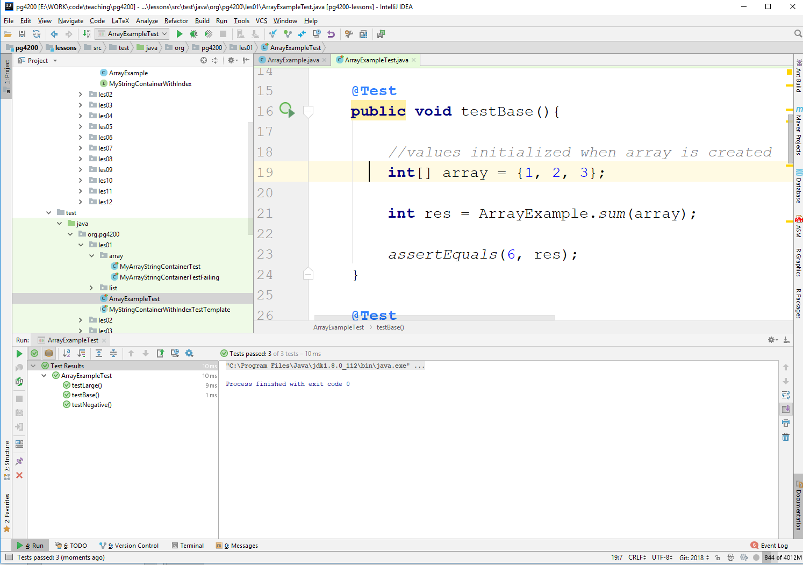
Running a Test
Right-click, and choose “Run <ClassName>”
Can also use “Debug” and “Run With Coverage”

Slide 42
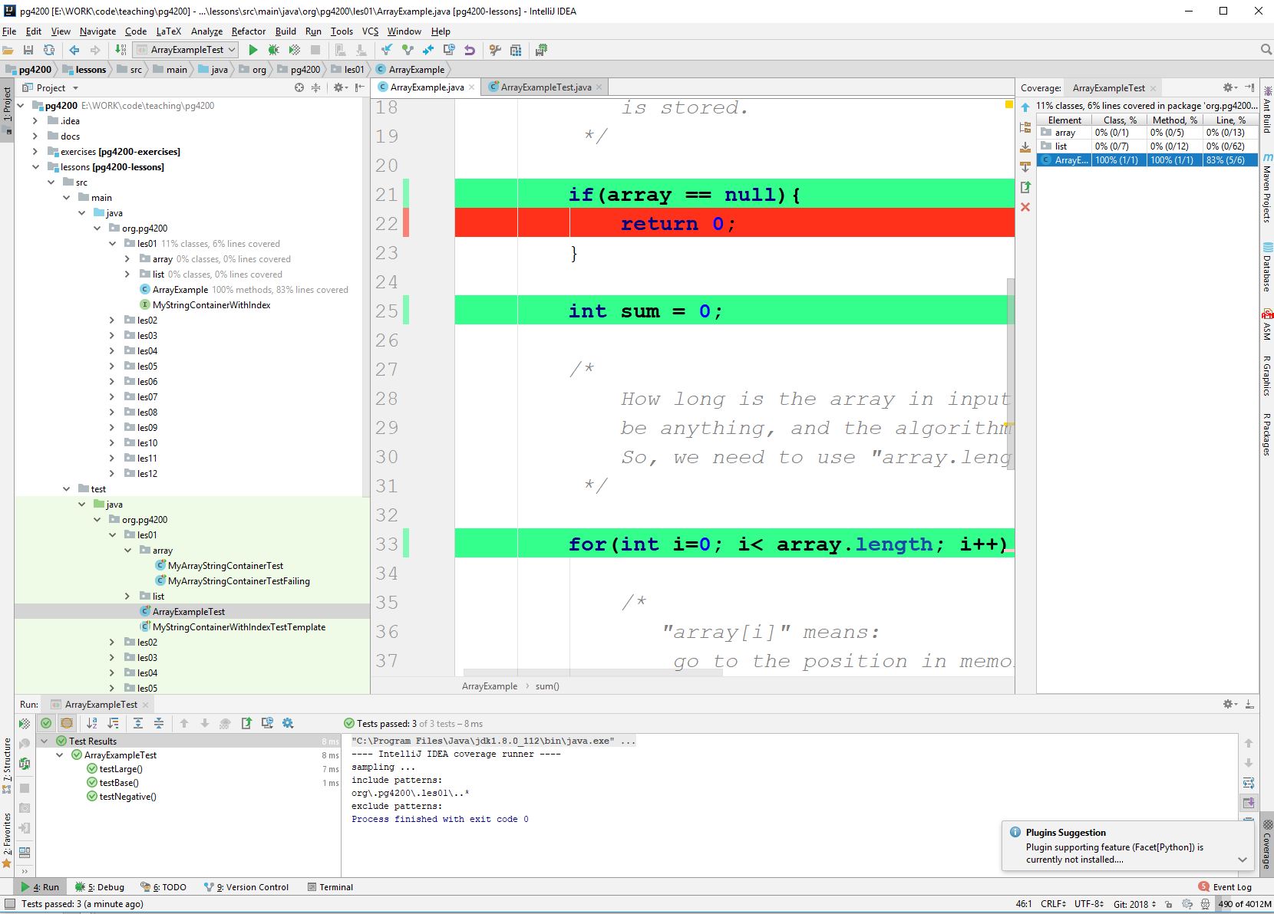
Run With Coverage
Can tell you how much of the code is executed
Eg, 83% in this case
Code that is never executed by a test, might have bugs

Slide 43
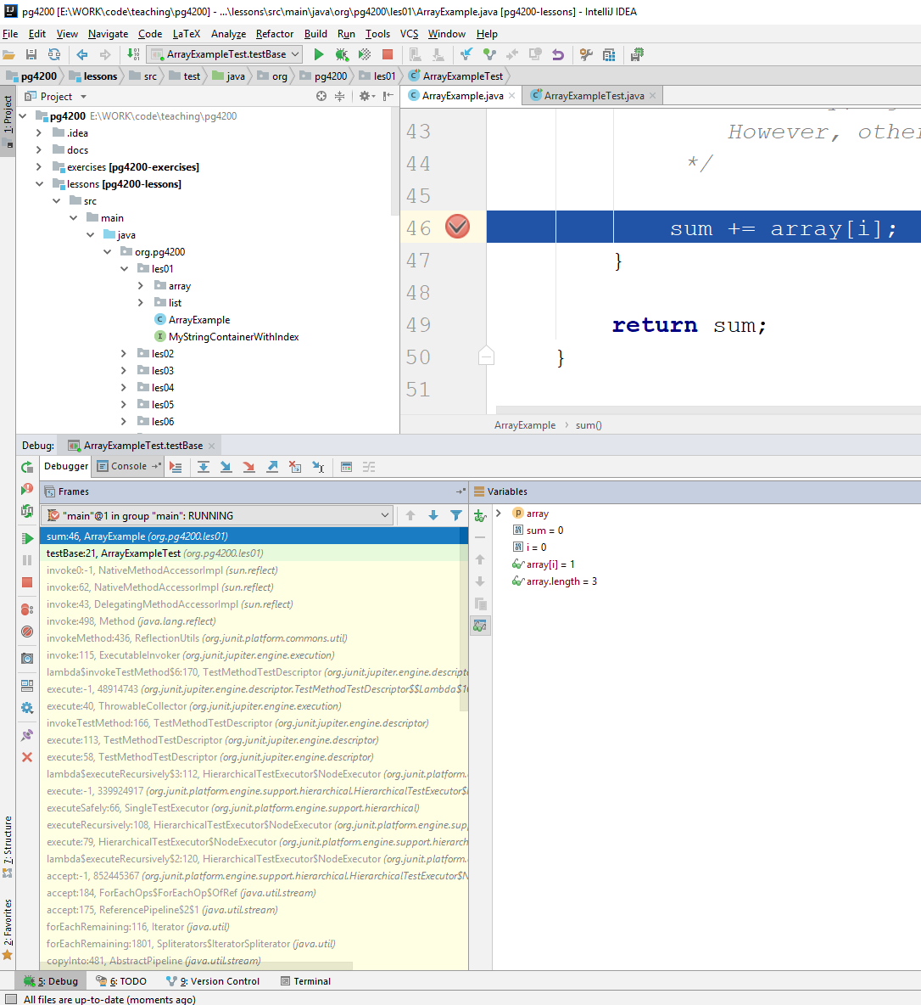
Debugging
VERY IMPORTANT
Can put “break points”
Execute one step at a time
Inspect status of all variables, at each step
Easier to understand with live demo

Slide 44
Breakpoints
One step forward
Run till next
breakpoint
Evaluate code on the fly
in current context
Step inside function call
State of variables

Slide 45
Homework
Study Book Chapter 1.1 and 1.2
Study code in the org.pg4200.les01 package
Do exercises in exercises/ex01
Extra: do exercises in the book

